Slide 1
TEACHING LEARNING MATERIAL · DEEP LEARNING
Session 5
Recurrent Neural Network
From the basic RNN cell, BPTT, and vanishing gradients, through LSTM, GRU,
sequence topologies, and a character-level text generation case study.
RNN cell
BPTT
LSTM / GRU
Bidirectional
Text generation
Dosen Penyusun:
David Agustriawan, S.Kom., M.S.c., Ph.D.
Ajie Kusuma Wardhana, S.Kom., M.Eng
Source: Deep Learning TLM session 5.pdf · Chapter 5 · TensorFlow / Keras
Notes:
Session opener. Emphasize that RNNs are used for sequential data: text, speech, time series.

Slide 2
SESSION MAP
What we will cover
01
The basic RNN cell
Hidden state, U–V–W matrices, unrolling, weight sharing
02
BPTT
Backward gradient flow, vanishing & exploding, clipping
03
Cell variants
LSTM, GRU, peephole LSTM
04
Architecture variants
Bidirectional, stateful, five topologies, Seq2Seq
05
Case study
RNN / LSTM / Seq2Seq data processing, then “Alice” text generation
TLM Deep Learning · Session 5 · Recurrent Neural Network
02
Notes:
Five blocks matching the Chapter 5 structure in the PDF.

Slide 3
MOTIVATION
Why an RNN, not a plain MLP?
RNNs exploit the sequential nature of their input.
Text
Speech
Words in a sentence depend on one another. 'bank' after 'river' ≠ 'bank' after 'money'.
Phonemes and words in speech recognition only make sense in order.
Time series
Molecules / music
Stock prices, sensors, weather: the value at t depends on earlier values.
Atoms in a compound or notes in a composition are recursive sequences.
TLM Deep Learning · Session 5 · Recurrent Neural Network
03
Notes:
Page 1 PDF: speech recognition, language modelling, machine translation, sentiment, image captioning.

Slide 4
A BROKEN ASSUMPTION
MLPs treat inputs as independent
Multilayer Perceptron
Recurrent Neural Network
• Each sample / feature is treated as independent.
• There is no memory of the previous step.
• Input length must be fixed.
• Good for tabular data or static images; weak for sequences.
• Hidden state ht stores the essence of what has been seen so far.
• ht = Φ(ht−1, xt) — recursive back to the start of the sequence.
• The same cell is reused (parameter sharing).
• In principle, it can process sequences of arbitrary length.
TLM Deep Learning · Session 5 · Recurrent Neural Network
04

Slide 5
THE BASIC RNN CELL
Hidden state as memory
Recursive equation (notes, p. 1)
h = Φ( h , x )
t t−1 t
h_t = Φ( h_{t−1} , x_t )
h_t
h_{t−1}
x_t
Hidden state at time t — a summary of the sequence so far.
Memory from the previous step; unfolds all the way back to h_0.
Input at step t: a token, a time sample, or a feature vector.
Because the equation is recursive, h_{t−1} = Φ(h_{t−2}, x_{t−1}), and so on. That is how an RNN encodes information from sequences that are, in principle, arbitrarily long.
TLM Deep Learning · Session 5 · Recurrent Neural Network
05

Slide 6
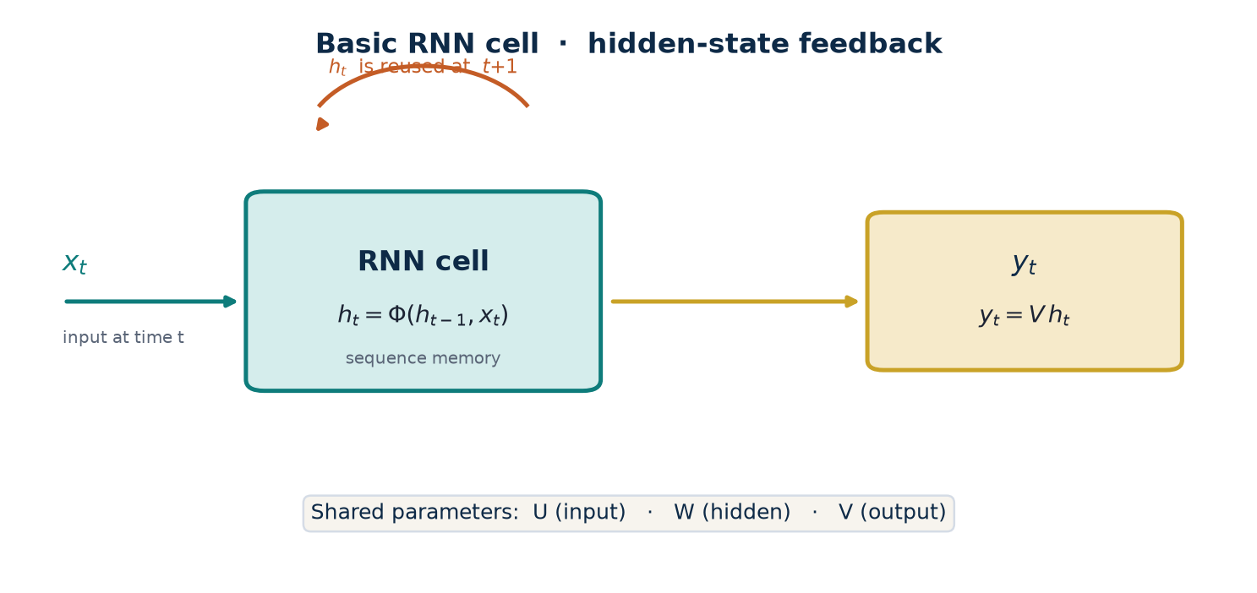
FIGURE 5.1(A)
The RNN cell, drawn graphically
TLM Deep Learning · Session 5 · Recurrent Neural Network
06
Notes:
At time t the cell has input x(t) and output y(t). Part of the output (ht) is fed back for t+1.

Slide 7
PARAMETERS
Three weight matrices: U, V, and W
U
Input → hidden
Maps x_t into a contribution to memory.
W
Hidden → hidden
Transforms h_{t−1}. Source of vanishing/exploding gradients.
V
Hidden → output
Reads h_t into the prediction y_t.
TLM Deep Learning · Session 5 · Recurrent Neural Network
07

Slide 8
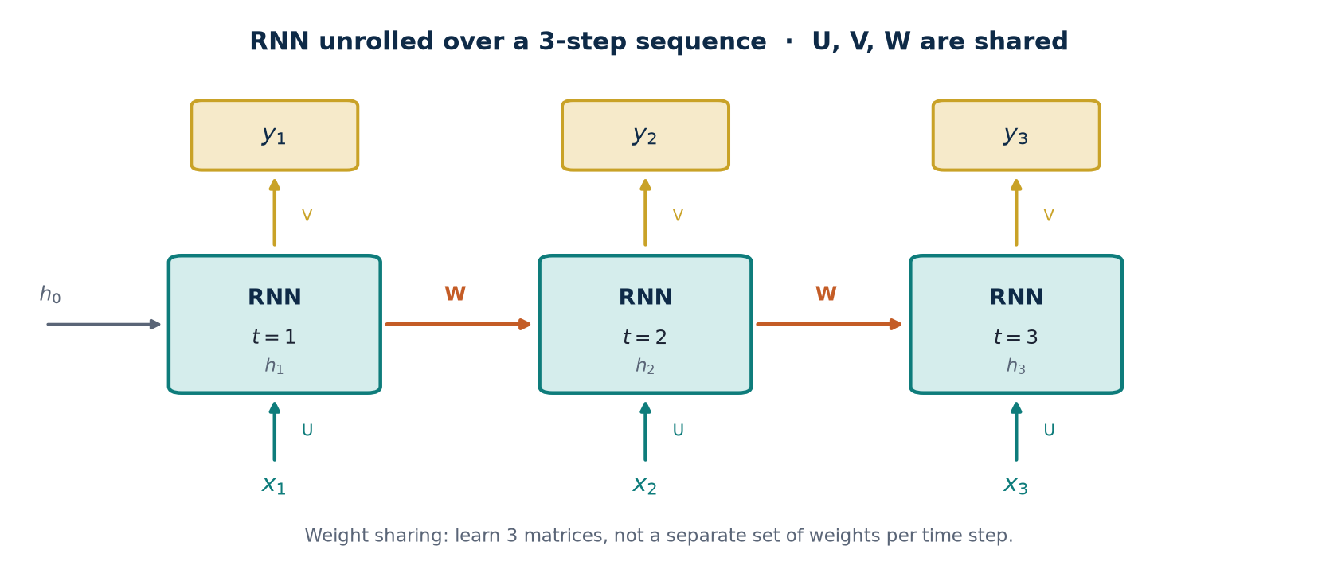
FIGURE 5.1(B)
The network unrolled over the full sequence
TLM Deep Learning · Session 5 · Recurrent Neural Network
08
Notes:
U, V, W are shared at every step. This drastically reduces the number of parameters.

Slide 9
COMPUTATION GRAPH
Forward pass of a SimpleRNN cell
Internal equations (notes, p. 2)
h_t = tanh( W h_{t−1} + U x_t )
y_t = V h_t (then softmax if classifying tokens)
tanh, not sigmoid
Keras
Weight sharing
More efficient to learn in practice and helps combat vanishing gradients.
SimpleRNN is the cell above. Advanced variants: LSTM and GRU.
The same operation is applied to different inputs at each t.
TLM Deep Learning · Session 5 · Recurrent Neural Network
09

Slide 10
WORKED EXAMPLE · 1
Scalar RNN forward pass, 3 steps
Assume 1-D values so the recursive chain is visible. U = 0.5, W = 0.8, V = 1.2, h_0 = 0.
Given
Computation
x1 = 1.00
x2 = 0.50
x3 = −0.30
h_t = tanh(W h_{t−1} + U x_t)
y_t = V h_t
tanh(z) = (e^z − e^{−z}) / (e^z + e^{−z})
t = 1
h1 = tanh(0.8·0 + 0.5·1.00) = tanh(0.500) = 0.462
y1 = 1.2·0.462 = 0.555
t = 2
h2 = tanh(0.8·0.462 + 0.5·0.50) = tanh(0.620) = 0.551
y2 = 1.2·0.551 = 0.661
t = 3
h3 = tanh(0.8·0.551 + 0.5·(−0.30)) = tanh(0.291) = 0.283
y3 = 1.2·0.283 = 0.339
TLM Deep Learning · Session 5 · Recurrent Neural Network
10
Notes:
Stress that h3 already 'contains' x1, x2, x3 through the chain h2 and h1.

Slide 11
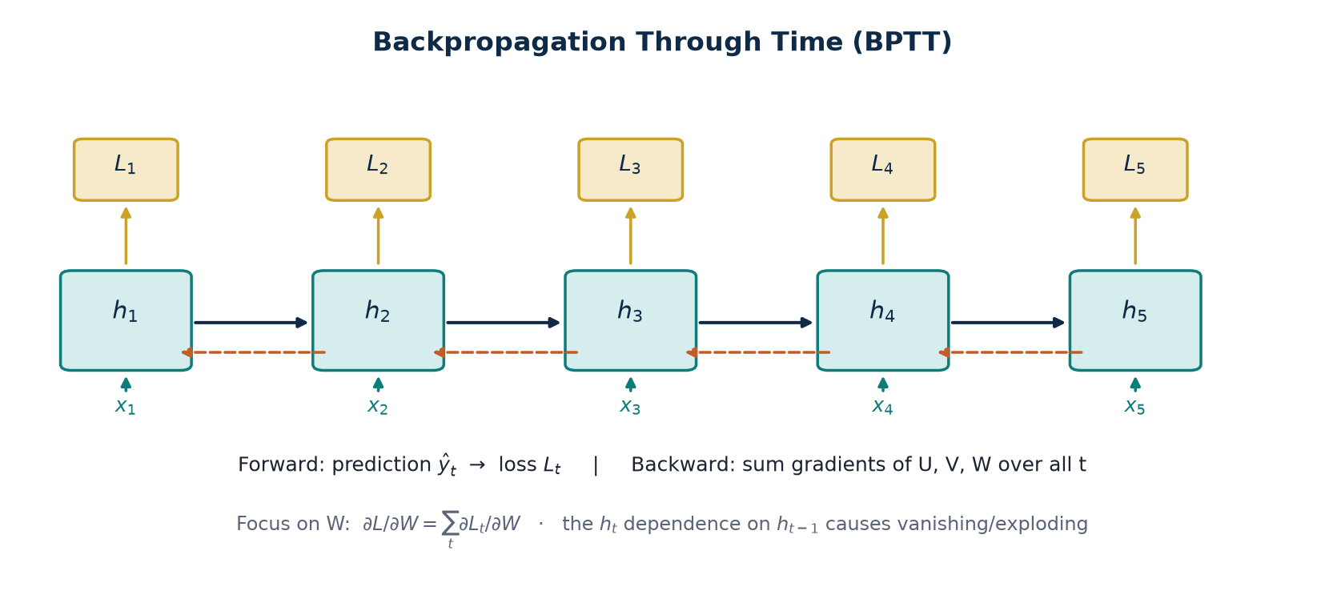
FIGURE 5.2
Backpropagation Through Time (BPTT)
TLM Deep Learning · Session 5 · Recurrent Neural Network
11
Notes:
Forward: ŷ_t vs y_t → L_t. Backward: gradients of U, V, W are summed over all t.

Slide 12
WORKED EXAMPLE · 2
BPTT chain rule at t = 3
Focus on W because the chain h_t → h_{t−1} → … causes vanishing/exploding.
Decomposition (notes, p. 3)
∂L₃/∂W = (∂L₃/∂y₃) (∂y₃/∂h₃) (∂h₃/∂W)
∂L₃ / ∂W = (∂L₃ / ∂ŷ₃) · (∂ŷ₃ / ∂h₃) · (∂h₃ / ∂W)
∂h₃/∂W still expands because h₃ depends on W both directly and through h₂, h₁
∂h₃/∂W = ∂h₃/∂W |direct + (∂h₃/∂h₂)(∂h₂/∂W |direct) + (∂h₃/∂h₂)(∂h₂/∂h₁)(∂h₁/∂W)
If |∂h_t / ∂h_{t−1}| = γ < 1, the product γ^{t−k} shrinks toward 0 → vanishing.
If |γ| > 1, the product blows up to ∞ / NaN → exploding.
Total gradient: ∂L/∂W = Σ_t ∂L_t/∂W (summed over all time steps).
TLM Deep Learning · Session 5 · Recurrent Neural Network
12

Slide 13
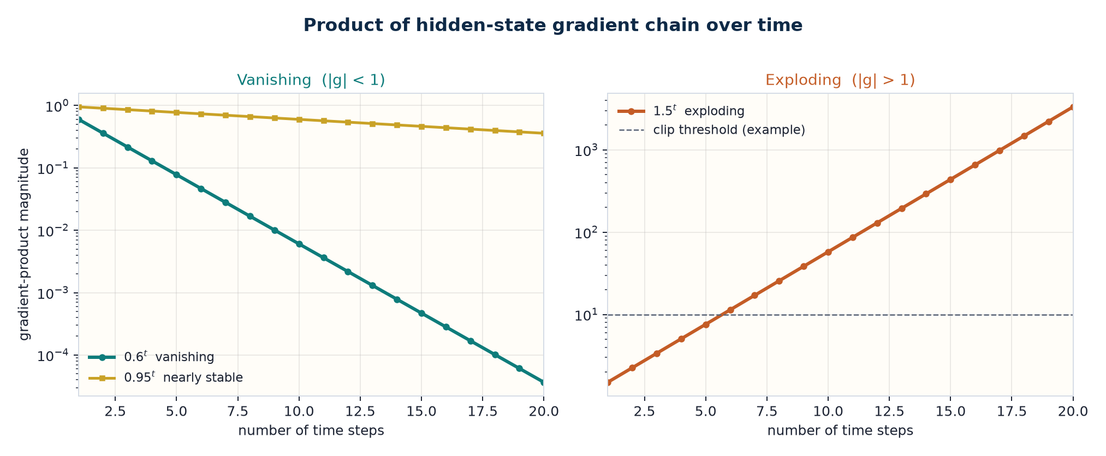
VISUALIZATION
Vanishing vs exploding gradients
TLM Deep Learning · Session 5 · Recurrent Neural Network
13

Slide 14
WORKED EXAMPLE · 3
Chain products and clipping
Vanishing: γ = 0.6
Exploding: γ = 1.5
5 steps: 0.6^5 = 0.078
10 steps: 0.6^10 = 0.00605
20 steps: 0.6^20 = 3.66 × 10^−5
The signal from the start of the sequence almost disappears.
The RNN fails to learn long-range dependencies.
5 steps: 1.5^5 = 7.59
10 steps: 1.5^10 = 57.7
20 steps: 1.5^20 ≈ 3325
Gradients → NaN, training crashes. Easier to detect.
Control: clipvalue / clipnorm, or tf.clip_by_value.
TLM Deep Learning · Session 5 · Recurrent Neural Network
14

Slide 15
MITIGATION
What can we do about vanishing gradients?
Initialize W
Stronger regularization
ReLU, not tanh
Initialize the hidden matrix so the singular-value spectrum stays near 1.
Keep weight magnitudes in check so the chain product does not explode or collapse.
ReLU derivative = 1 on the active region, reducing saturation.
Pretraining
LSTM / GRU
Gradient clipping
Pretrain layers unsupervised before labelled fine-tuning.
The most popular fix: gates designed for long-term dependencies.
For exploding gradients: clip at clipvalue or clipnorm.
TLM Deep Learning · Session 5 · Recurrent Neural Network
15

Slide 16
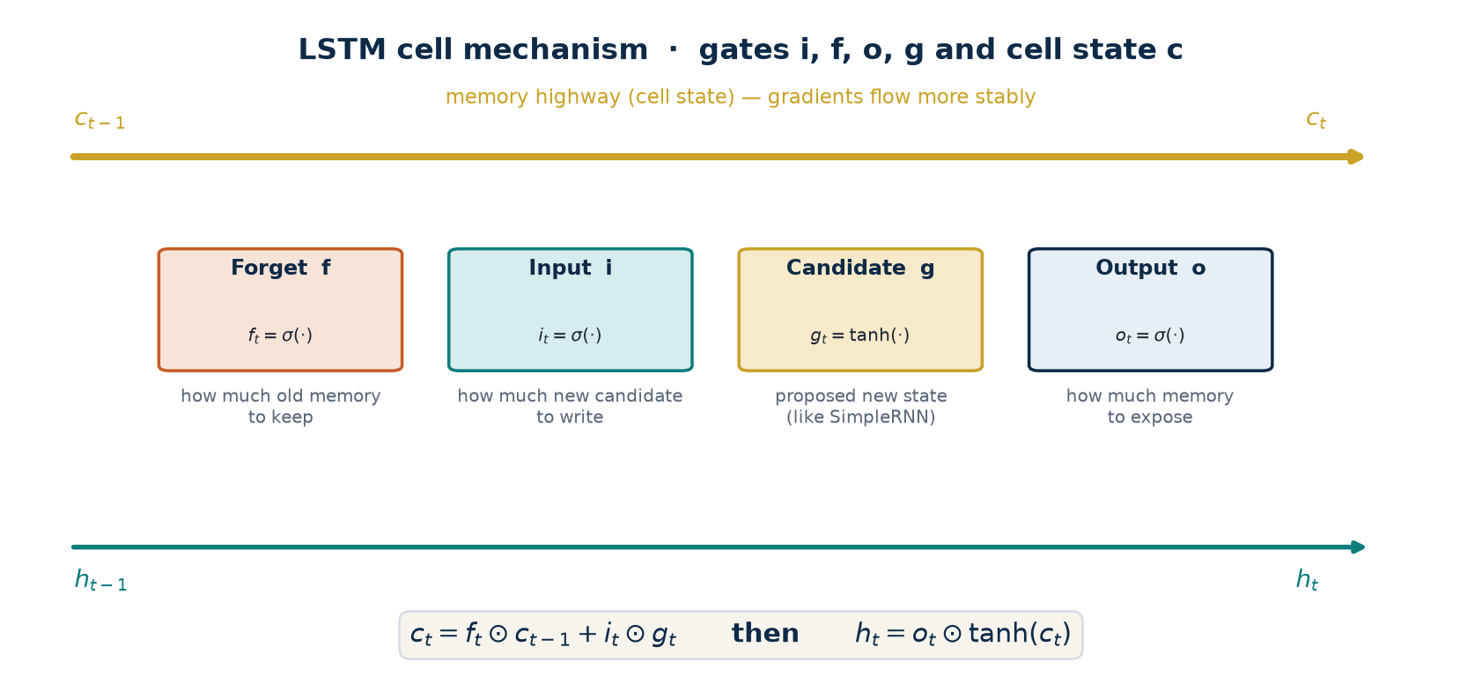
CELL VARIANT · LSTM
Long Short-Term Memory
• SimpleRNN combines h_{t−1} and x_t through a single tanh layer.
• LSTMs are also recurrent, but use four layers that interact in a specific way.
• Drop-in replacement: swap SimpleRNN for LSTM with no architectural side effects; usually better results, longer training.
TLM Deep Learning · Session 5 · Recurrent Neural Network
16

Slide 17
LSTM MECHANISM
Gate equations (Figure 5.3)
Forget gate
f_t = σ(W_f x_t + U_f h_{t−1} + b_f)
How much of c_{t−1} is allowed through.
Input gate
i_t = σ(W_i x_t + U_i h_{t−1} + b_i)
How much of the new candidate is written.
Output gate
o_t = σ(W_o x_t + U_o h_{t−1} + b_o)
How much of the memory is exposed.
Candidate g
g_t = tanh(W_g x_t + U_g h_{t−1} + b_g)
New state — same form as SimpleRNN.
c_t = f_t ⊙ c_{t−1} + i_t ⊙ g_t h_t = o_t ⊙ tanh(c_t)
Note: the PDF writes 'forget gate g' — it means the forget gate f. σ squeezes gate outputs to (0, 1) so they act as element-wise valves.
TLM Deep Learning · Session 5 · Recurrent Neural Network
17

Slide 18
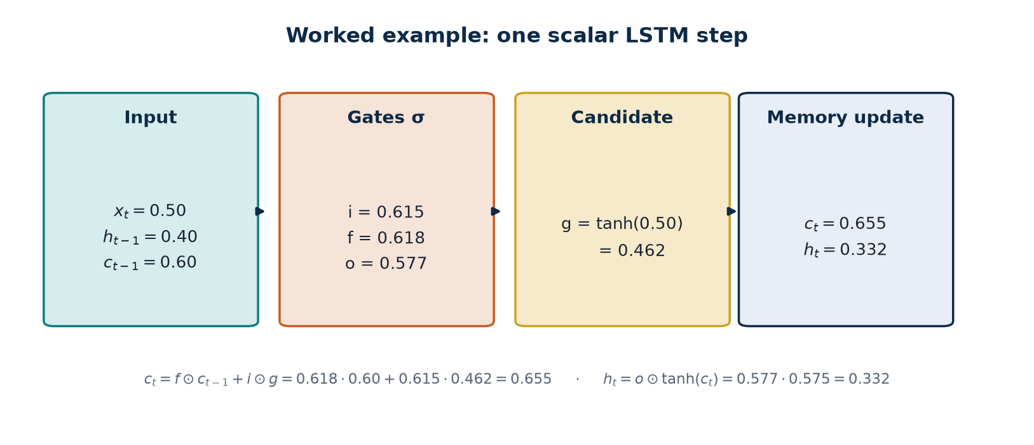
WORKED EXAMPLE · 4
One scalar LSTM step
σ and tanh detail
i: σ(0.47) = 0.615
f: σ(0.48) = 0.618
o: σ(0.31) = 0.577
g: tanh(0.50) = 0.462
c = f·c_prev + i·g
= 0.618·0.60
+ 0.615·0.462
= 0.655
h = o·tanh(c)
= 0.577·0.575
= 0.332
TLM Deep Learning · Session 5 · Recurrent Neural Network
18
Notes:
If f→0, old memory is ignored. If i→0, the new candidate is ignored. These valves fight vanishing gradients.

Slide 19
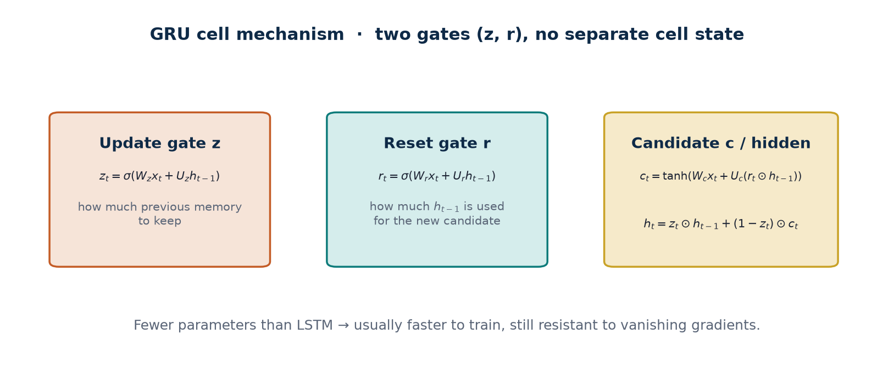
CELL VARIANT · GRU
Gated Recurrent Unit: simpler, still vanishing-resistant
TLM Deep Learning · Session 5 · Recurrent Neural Network
19

Slide 20
WORKED EXAMPLE · 5
One scalar GRU step
x_t = 0.50, h_{t−1} = 0.40. Illustrative weights: all W = 0.5, U = 0.4, bias = 0.
Computation order
z and r use sigmoid; candidate c uses tanh; h_t interpolates between h_{t−1} and c.
z_t = σ(W_z x_t + U_z h_{t−1}) r_t = σ(W_r x_t + U_r h_{t−1}) h_t = z_t⊙h_{t−1} + (1−z_t)⊙c_t
1. Update z
2. Reset r
3. Candidate c
4. New hidden
z = σ(0.5·0.50 + 0.4·0.40)
= σ(0.410) = 0.601
r = σ(0.5·0.50 + 0.4·0.40)
= σ(0.410) = 0.601
c = tanh(0.5·0.50 + 0.4·(r·h))
= tanh(0.346) = 0.333
h = z·h_prev + (1−z)·c
= 0.601·0.40 + 0.399·0.333
= 0.373
TLM Deep Learning · Session 5 · Recurrent Neural Network
20

Slide 21
CELL VARIANT · PEEPHOLE LSTM
Gates may 'peek' at the cell state
The only difference from a standard LSTM: an extra + p ⊙ c_{t−1} term on gates i, f, o.
i_t = σ(W_i x_t + U_i h_{t−1} + P_i c_{t−1})
f_t and o_t are analogous; g_t and the c_t / h_t updates stay the same.
TensorFlow 2 — wrap the experimental cell in an RNN wrapper
cell = tf.keras.experimental.PeepholeLSTMCell(units=128)
layer = tf.keras.layers.RNN(cell, return_sequences=True)
# or a list of cells inside RNN(...)
TLM Deep Learning · Session 5 · Recurrent Neural Network
21

Slide 22
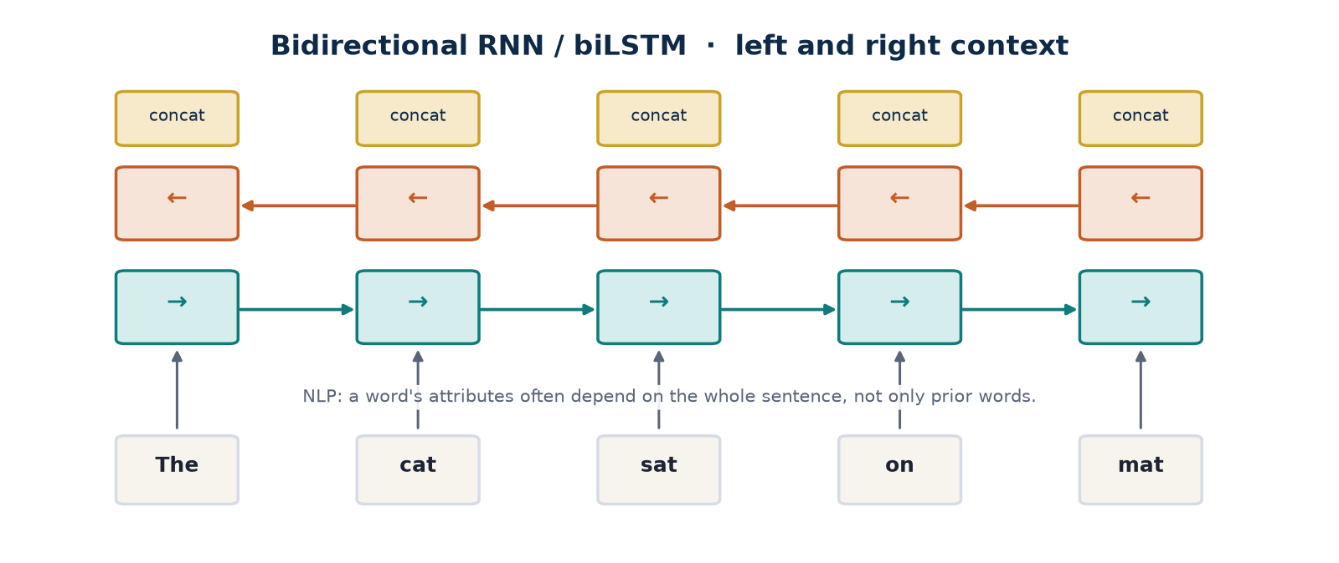
ARCHITECTURE VARIANT
Bidirectional RNN / biLSTM (Figure 5.4)
TLM Deep Learning · Session 5 · Recurrent Neural Network
22

Slide 23
ARCHITECTURE VARIANT
Stateful RNN: memory across batches
Stateless (Keras default)
Stateful = True
• State is reset after every batch.
• Safe if batches are shuffled.
• No context is carried between chunks.
• h from batch n becomes the initial h of batch n+1.
• The network can build state across the training sequence.
• State can also be kept at prediction time.
Practical consequences
Benefit: smaller networks and/or shorter training. Cost: batch size must reflect the data period, reset state after each epoch, and do not shuffle — order matters.
TLM Deep Learning · Session 5 · Recurrent Neural Network
23

Slide 24
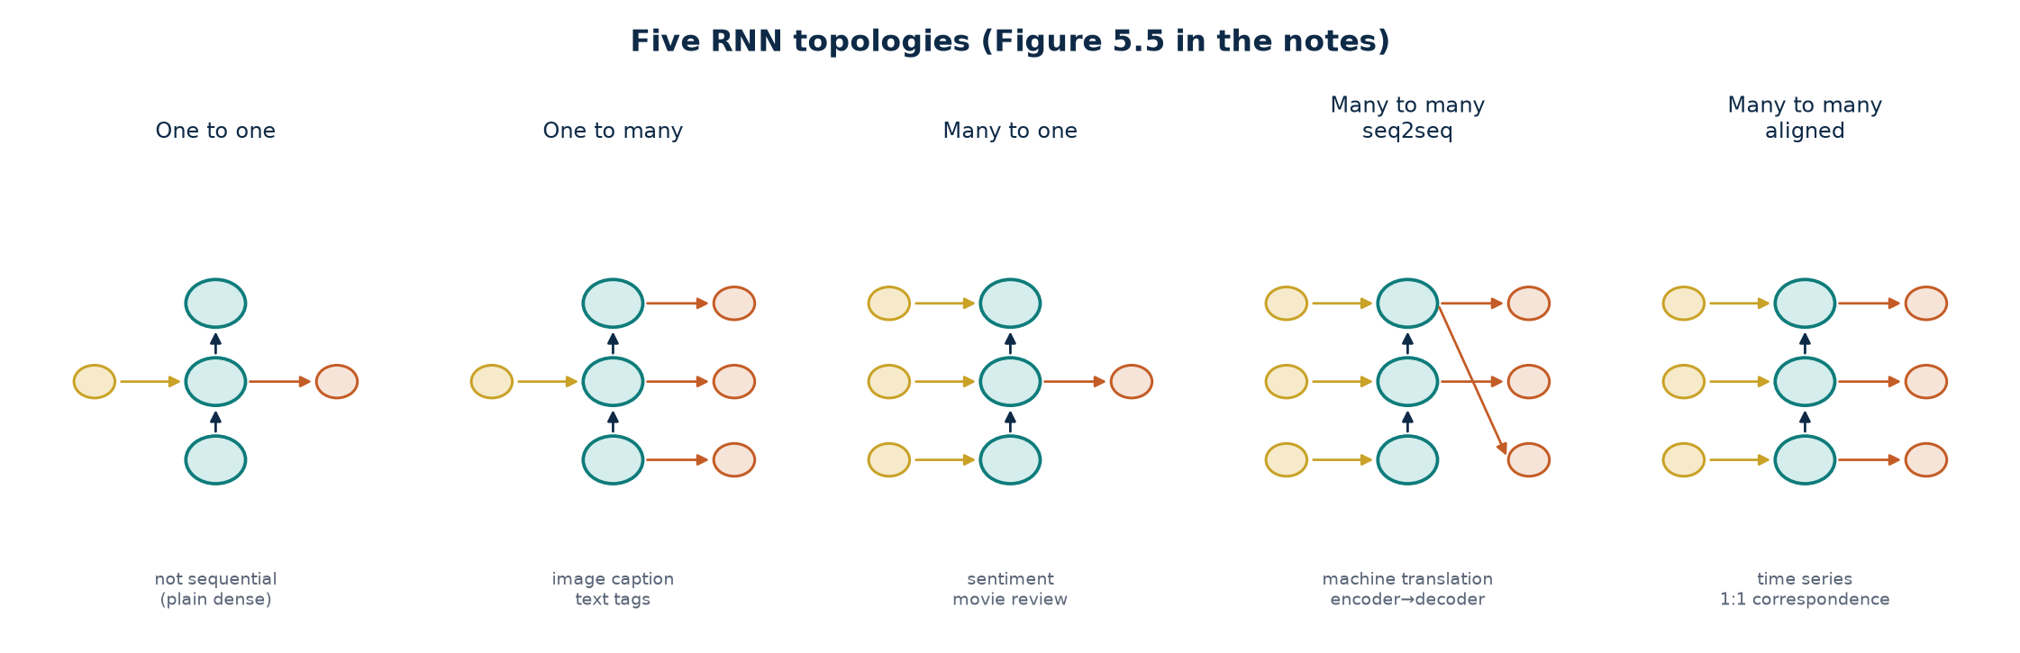
FIGURE 5.5
Five RNN input–output topologies
TLM Deep Learning · Session 5 · Recurrent Neural Network
24

Slide 25
READING THE TOPOLOGIES
When to use which?
One-to-one
1 tensor → 1 tensor
Not sequence processing; a dense net is enough.
One-to-many
1 tensor → sequence
Text tags from images; image captioning.
Many-to-one
sequence → 1 tensor
Sentiment analysis of a movie review.
Many-to-many seq2seq
sequence → context → sequence
Machine translation; tasks framed as translation. Encoding must finish first.
Many-to-many aligned
one output cell per input cell
1:1 time series. Decoding can start before encoding finishes.
TLM Deep Learning · Session 5 · Recurrent Neural Network
25

Slide 26
MANY-TO-MANY · SEQ2SEQ
Sequence-to-sequence (notes, p. 8)
The more popular many-to-many : read a sequence, compress it to a context vector, then write a new sequence.
1. Encode
2. Context c
3. Decode
An encoder RNN reads x1 … xT. The last hidden state (or a function of all h) becomes the context vector c that represents the whole input.
c is a fixed-size bridge. Source and target lengths need not match — ideal for translation and any task that can be framed as translation.
A decoder RNN is initialized from c, then emits y1, y2, … until an end token. Each step uses the previous output.
Typical tasks
Machine translation (je suis → I am), summarization, chatbots, and any problem that can be rewritten as “source sequence → target sequence”.
TLM Deep Learning · Session 5 · Recurrent Neural Network
26
Notes:
Stress: seq2seq is many-to-many with a context bottleneck, not a 1:1 correspondence.

Slide 27
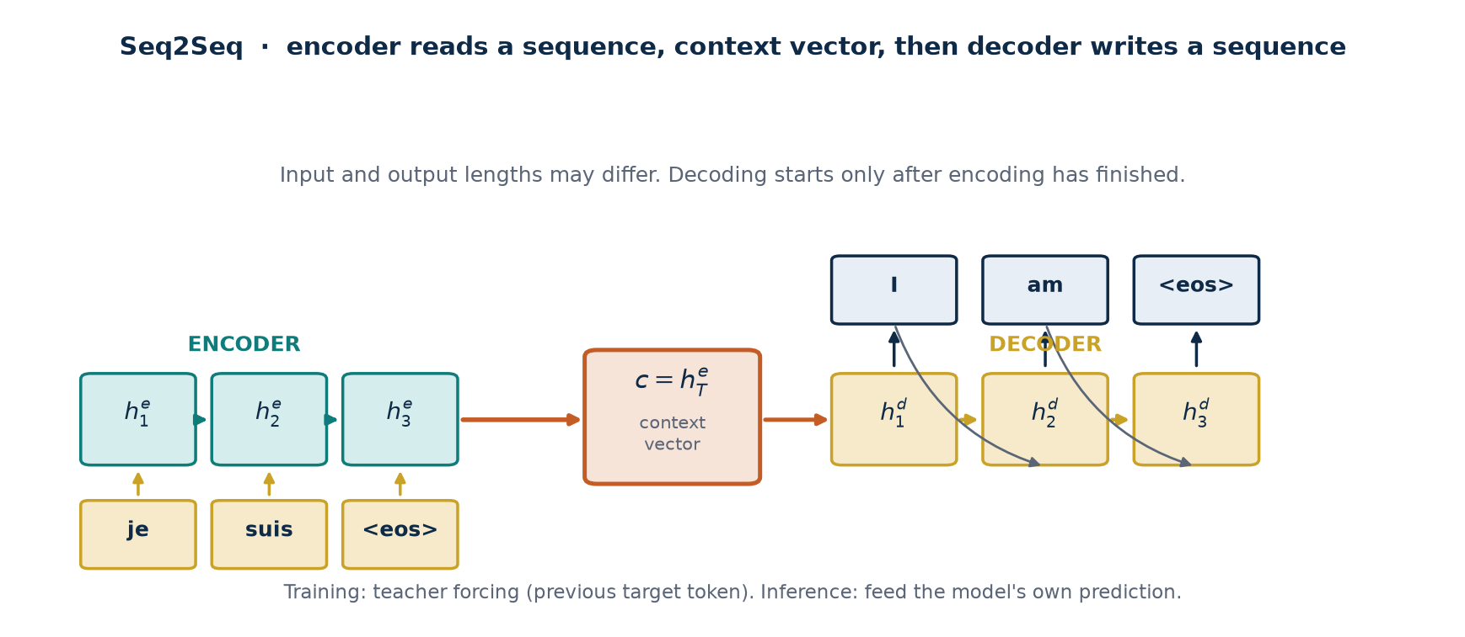
SEQ2SEQ MECHANISM
Encoder → context vector → decoder
TLM Deep Learning · Session 5 · Recurrent Neural Network
27
Notes:
Decoding starts only after the full input is encoded. Training: teacher forcing. Inference: feed the model's own prediction.

Slide 28
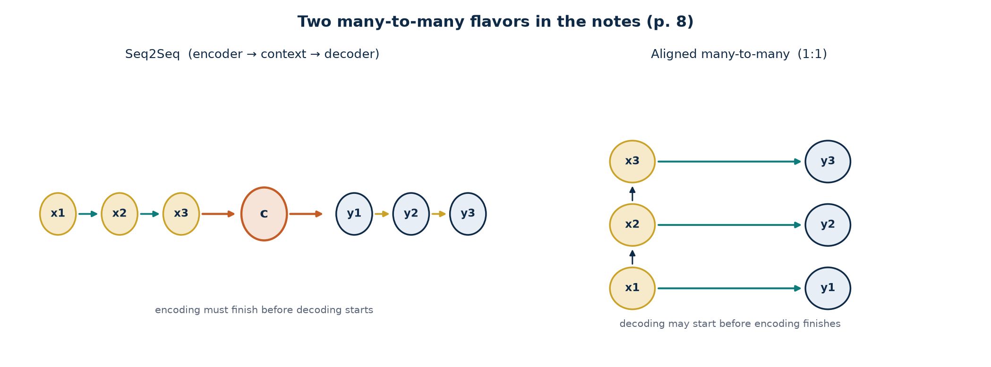
TWO MANY-TO-MANY
The key difference
What differs
• Seq2Seq: the input must be fully encoded before decoding begins.
• Aligned: each input cell has an output cell; decoding may overlap.
• Seq2Seq allows different lengths and word reordering.
• Aligned fits 1:1 time series (e.g. per-step labels).
• c is a bottleneck: the whole source is squeezed into one fixed vector.
TLM Deep Learning · Session 5 · Recurrent Neural Network
28

Slide 29
WORKED EXAMPLE · SEQ2SEQ
Scalar translation: je suis → I am
Encoder and decoder use U = 0.5, W = 0.8. h0 = 0. Context c = last encoder hidden.
Encoder (read source)
Decoder (write target)
x_je = 1.00 x_suis = 0.50
h = tanh(W h_prev + U x)
h1 = tanh(0.8·0 + 0.5·1.00)
= tanh(0.500) = 0.462
h2 = tanh(0.8·0.462 + 0.5·0.50)
= tanh(0.620) = 0.551
c = h2 = 0.551
all of 'je suis' is compressed into c
s0 = c = 0.551 SOS = 0
s1 = tanh(0.8·0.551 + 0.5·0)
= tanh(0.441) = 0.414
illustrative logits: z_I=1.80, z_am=0.40
P(I) = e^1.80 / (e^1.80+e^0.40) = 0.802
P(am) = 0.198 → emit “I”
Teacher-force e_I = 1.00
s2 = tanh(0.8·0.414 + 0.5·1)
= tanh(0.831) = 0.681
TLM Deep Learning · Session 5 · Recurrent Neural Network
29
Notes:
c must be formed first. Decoder softmax picks a token; the next step uses that token (inference) or the target (teacher forcing).

Slide 30
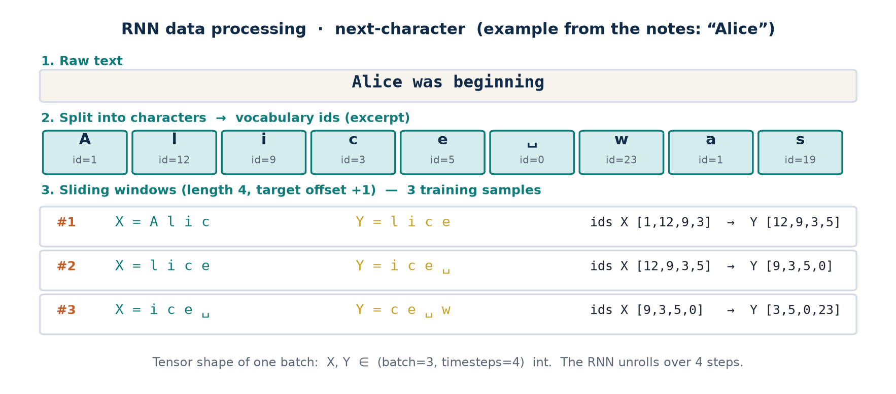
DATA PROCESSING · RNN
Next-character: from a string to a (batch, T) tensor
Example follows the notes' case study: character windows with the target shifted by 1.
TLM Deep Learning · Session 5 · Recurrent Neural Network
30
Notes:
Show three window samples from 'Alice was'. Aligned many-to-many RNN: each step predicts the next character.

Slide 31
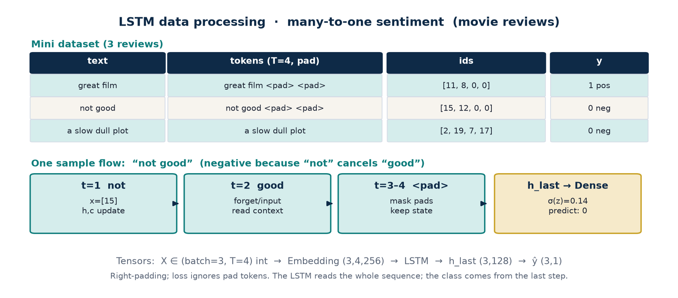
DATA PROCESSING · LSTM
Many-to-one sentiment: tokenize, pad, take h_last
Three movie reviews. Variable length is padded to T=4 with <pad>. The class is read from the last hidden state.
TLM Deep Learning · Session 5 · Recurrent Neural Network
31
Notes:
Same sequential data as an RNN, but LSTM keeps the context of 'not' while reading 'good'. Pads are masked.

Slide 32
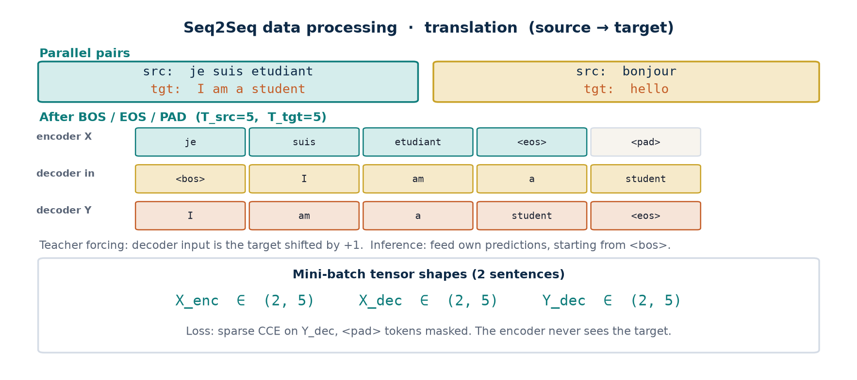
DATA PROCESSING · SEQ2SEQ
Parallel translation: encoder X, decoder in, decoder Y
Two FR→EN pairs. The target is shifted +1 for teacher forcing. <pad> is excluded from the loss.
TLM Deep Learning · Session 5 · Recurrent Neural Network
32
Notes:
Unlike RNN/LSTM there are TWO sequences. The encoder must never see the target.

Slide 33
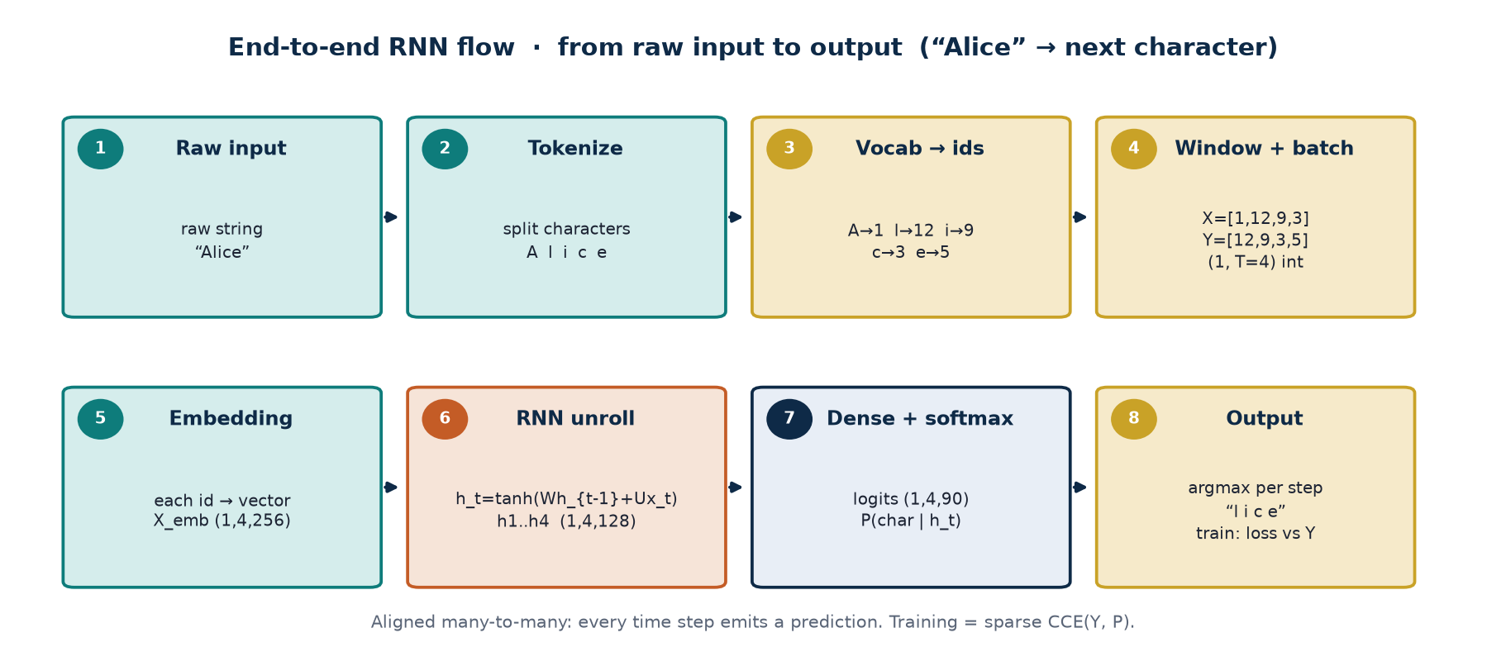
END-TO-END FLOW · RNN
8 stages: raw text → predicted characters
Example: “Alice” → X=[A,l,i,c] → output “l i c e”. Aligned many-to-many.
TLM Deep Learning · Session 5 · Recurrent Neural Network
33
Notes:
Stress the h_t chain. Training compares softmax with Y; inference greedily samples or argmaxes the next char.

Slide 34
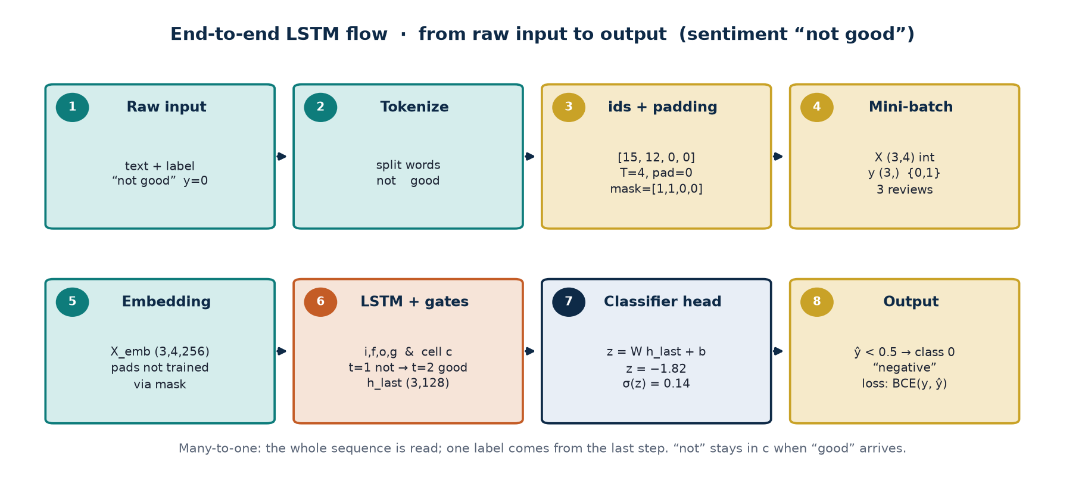
END-TO-END FLOW · LSTM
8 stages: review → sentiment class
Example: “not good”, y=0. Many-to-one: read the whole sequence, one output from h_last.
TLM Deep Learning · Session 5 · Recurrent Neural Network
34
Notes:
Gates i,f,o,g keep ‘not’ in the cell state. Pads are masked. Threshold the sigmoid at 0.5.

Slide 35
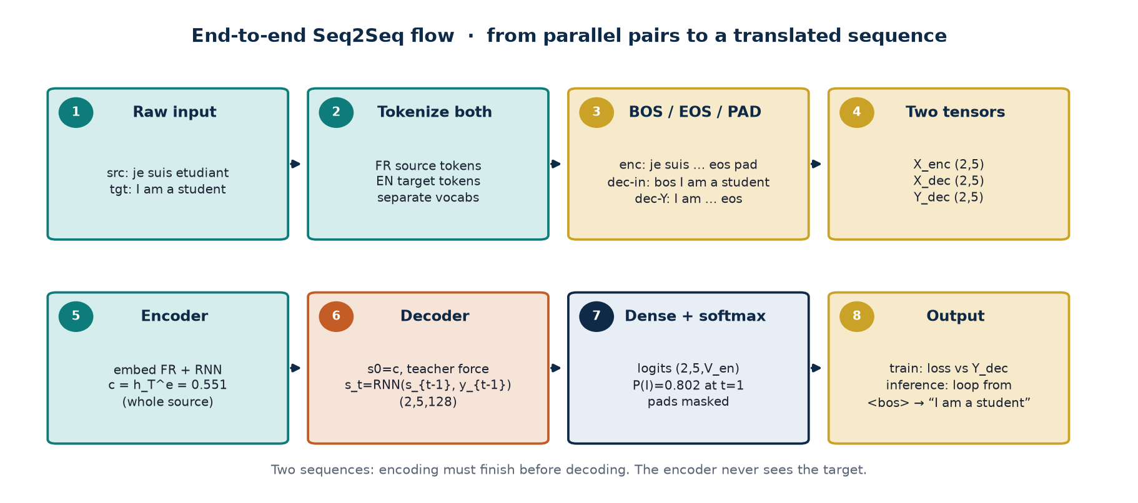
END-TO-END FLOW · SEQ2SEQ
8 stages: parallel pair → translated sequence
Example: je suis etudiant → I am a student. Encoding finishes before decoding starts.
TLM Deep Learning · Session 5 · Recurrent Neural Network
35
Notes:
Train with teacher forcing. Infer by looping from <sos> until <eos>. The encoder never sees the target.

Slide 36
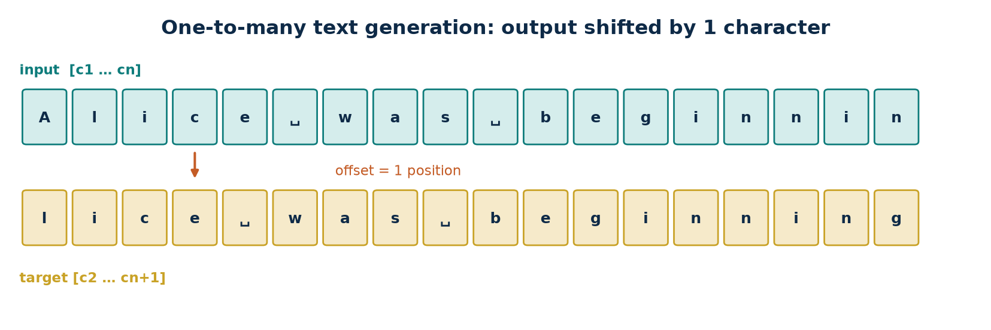
CASE STUDY
One-to-many: learning to generate text
Two Project Gutenberg novels. Generation prefix: “Alice”.
Input: 100 characters. Target: 100 characters shifted by 1 position. Train for 50 epochs; after every epoch generate a sequence with prefix “Alice”. Checkpoint every 10 epochs to CHECKPOINT_DIR.
TLM Deep Learning · Session 5 · Recurrent Neural Network
36

Slide 37
DATA PIPELINE
From characters to batched tensors
1
Download
tf.keras.utils.get_file() from Project Gutenberg; strip newlines and BOM.
2
Vocabulary
90 unique characters: letters, digits, symbols. Build char↔int maps.
3
Windows
Batch 101-character slices, then split_train_labels() → pairs of length (100, 100).
4
Batches
Shuffle sequences, batch size 64. Each element: two (64, 100) matrices of tf.int64.
TLM Deep Learning · Session 5 · Recurrent Neural Network
37

Slide 38
MODEL ARCHITECTURE
Embedding → stateful GRU → Dense
Input
(64, 100)
Integer sequence, num_timesteps = 100
Embedding
(64, 100, 256)
Each integer → a vector of embedding_dim = 256
GRU
(64, 100, 1024)
stateful=True, return_sequences=True, rnn_output_dim = 1024
Dense
(64, 100, 90)
Logits per position; vocab_size = 90
TLM Deep Learning · Session 5 · Recurrent Neural Network
38
Notes:
Loss: sparse categorical cross-entropy. Optimizer: Adam. Output (64,100,90) = character probabilities.

Slide 39
LOSS & GENERATION
Sparse CCE, Adam, and random sampling
Training
Decoding
• Standard loss for integer sequences: sparse categorical cross-entropy.
• Optimizer: Adam.
• 50 epochs; generate text every 10 epochs.
• Weights are saved, then a separate generative model is built with batch size = 1 so a single prefix “Alice” can be used.
• Because the model is stateful, call reset_states() before prediction so training hidden state does not leak.
• Pure argmax often produces repetitive text.
• Two common fixes: random sampling, or beam search (take the k most probable values).
• The notes use tf.random.categorical().
• Temperature T: divide logits by T before softmax. Small T → more predictable; large T → more random.
TLM Deep Learning · Session 5 · Recurrent Neural Network
39

Slide 40
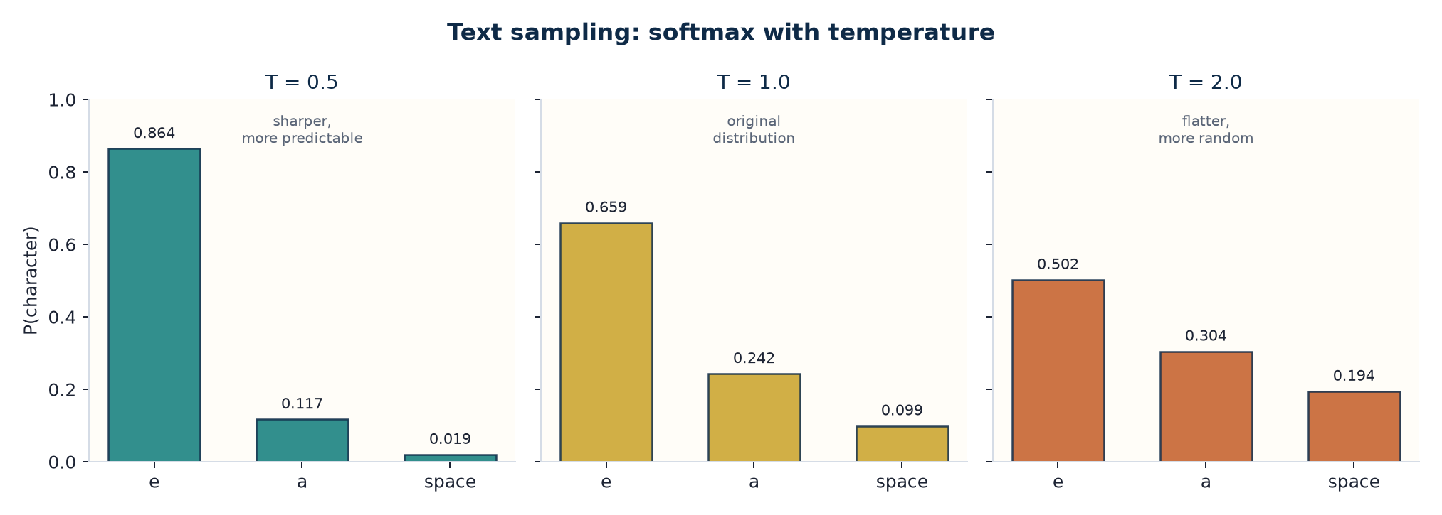
WORKED EXAMPLE · 6
Softmax with temperature
Suppose 3 character logits after the prefix “Alice”: e=2.0, a=1.0, space=0.1
Formula
p_i = exp(z_i / T)
/ Σ_j exp(z_j / T)
T = 0.5 → P(e) = 0.864
T = 1.0 → P(e) = 0.659
T = 2.0 → P(e) = 0.502
T ↓ the distribution locks onto the most likely token.
T ↑ the model is willing to pick less likely tokens — reducing repetition.
TLM Deep Learning · Session 5 · Recurrent Neural Network
40

Slide 41
SUMMARY
What should stick after this session
Recursive memory
BPTT
Gates
h_t = Φ(h_{t−1}, x_t) encodes a sequence through shared U, V, W.
Gradients are summed over time. The product |∂h_t/∂h_{t−1}| < 1 or > 1 decides vanishing/exploding.
LSTM (i, f, o, g + cell state) and GRU (z, r) preserve long-range dependencies.
Topologies
TF practice
Character text
Choose one-to-many, many-to-one, seq2seq (context vector), or aligned to match the task.
stateful, bidirectional wrapper, clipvalue, sparse CCE, temperature sampling.
Window 100, offset 1, GRU 1024, vocab 90, prefix “Alice”.
TLM Deep Learning · Session 5 · Recurrent Neural Network
41

Slide 42
FURTHER READING
Two sources named in the notes
WildML RNN tutorial — covers LSTMs in greater detail.
Christopher Olah, Understanding LSTM Networks — a visual, step-by-step walkthrough.
Chapter code: https://packt.link/dltfchp5
TLM Deep Learning · Session 5 · Recurrent Neural Network
Based on Deep Learning TLM session 5.pdf
Notes:
Close with a question: when is GRU enough, when LSTM, when is bidirectional required?

